Slide 1
Credit Card Fraud Analysis
Data Science 1 Team: Haroon Azhar Khan, Jyoti Shukla, Raghavendra Uppilisrinivasan, Purushottam Kumar, Baruni Prabaharan

Slide 2
Executive Summary
Business Context
Corporate credit card fraud results in avoidable financial losses, delayed reimbursement cycles, and added operational burden.
Manual review is reactive, inconsistent, and not scalable as transaction volumes grow.
Business Value
Reduce reimbursement of fraudulent charges before they impact financial statements.
Accelerate compliance review with automated triaging of suspicious activity.
Improve audit readiness through consistent, data‑driven fraud detection.
What We Did
Analyzed the Kaggle Credit Card Fraud dataset to replicate corporate card behaviors.
Conducted exploratory data analysis (EDA) and built three machine learning models: K‑Nearest Neighbors (KNN), Logistic Regression, Random Forest Classifier
Key Findings
Fraud cases are extremely rare (<0.2%), requiring models optimized for precision + recall, not accuracy.
Random Forest outperformed others, offering:
Strong ability to detect subtle fraud patterns
High interpretability through feature importance
Robustness to noise and imbalanced data
Recommendation
Proceed with a pilot deployment of the Random Forest model integrated into the reimbursement workflow to auto‑score transactions, surface high‑risk items to reviewers.
Notes:
BV: Scalable system adaptable to evolving fraud patterns using ongoing model retraining.

Slide 3
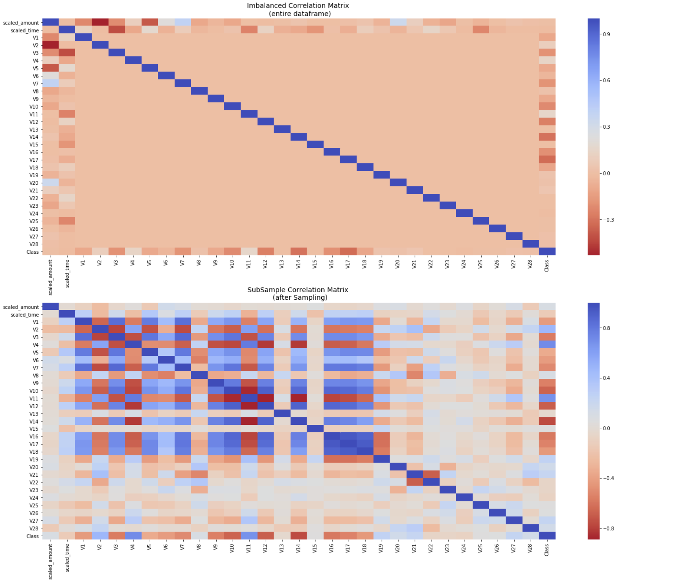
EDA – Key Takeaways
Sub-Sample:
Underfitting
Wrong correlation
Random Under Sampling
-Corrs: V17, V14, V12 and V10
+Corrs: V2, V4, V11, and V19
Anomaly Detection && Tradeoff
The lower the threshold the more outliers it will remove however, we want to focus more on "extreme outliers" rather than just outliers. Why? because we might run the risk of information loss which will cause our models to have a lower accuracy. You can play with this threshold and see how it affects the accuracy of our classification models.

Slide 4

KNN – Key Takeaways
The dataset is highly imbalanced, with fraud cases representing a very small percentage of total transactions. Therefore, evaluation metrics such as recall, precision, F1-score, and ROC-AUC are more meaningful than accuracy. Evaluation Matrix Observation:
Recall: 0.8469 - High: This means that the model correctly identifies 84.69% of the actual fraud cases.
Precision: 0.5461 - Low: This means that only 54.61% of the predicted fraud cases are actually fraud. This indicates a high false positive rate, which is common in imbalanced datasets.
F1-Score: 0.6678 - This is the harmonic mean of precision and recall, indicating a balance between the two.
ROC AUC: 0.9205 - This indicates that the model has a good ability to distinguish between the classes, with a score of 0.9205 suggesting strong performance.
Notes:
Puru

Slide 5
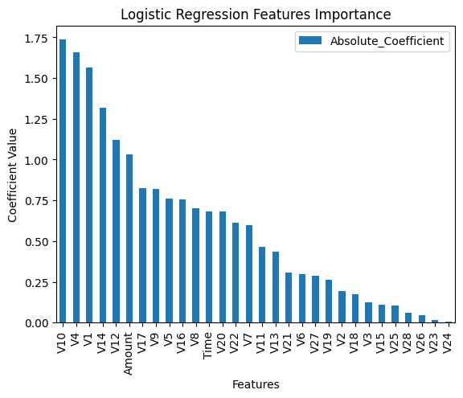
Logistic Regression – Key Takeaways
The Feature importance from Logistic Regression aligns with Box Whisker Plots in Exploratory Analysis.
We have used 'balanced' class weight in Logistic Regression Model & Stratified sampling to address class imbalance.
The Model's sensitivity/ Recall in fraud detection is about 88% , meaning the model still can produce False negatives that can be improved by either increasing the Fraudulent training data set and using methods like cross validation.

Slide 6
Random Forest - Overview
Model Overview
Implemented a Random Forest Classifier to detect fraudulent credit card transactions.
Random Forest combines multiple decision trees to improve prediction accuracy.
Each tree learns different patterns from the data and the final prediction is based on majority voting.
Why Random Forest
Handles large datasets and complex patterns effectively.
Reduces overfitting compared to a single decision tree.
Works well with high-dimensional data.

Slide 7
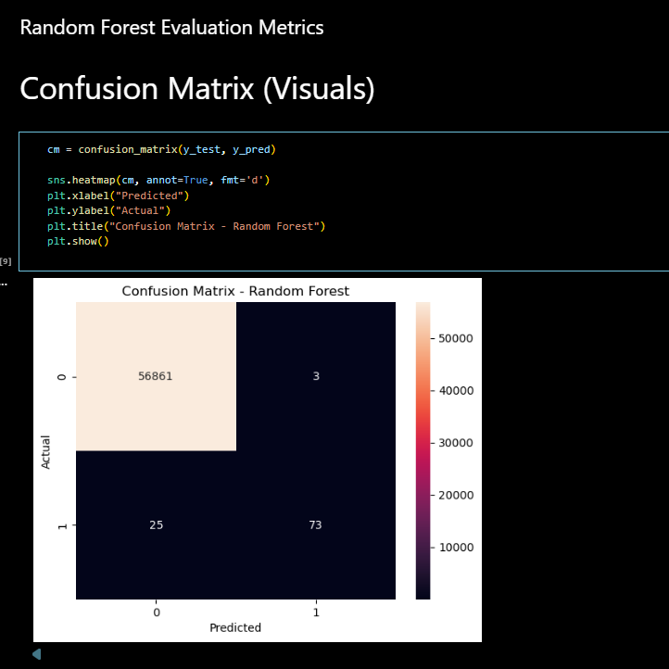
Random Forest – Evaluation Metrics

Slide 8
Key Takeaways
Observations
The dataset is highly imbalanced, with very few fraud cases.
Random Forest helped identify patterns associated with fraudulent transactions.
The model was evaluated using precision, recall, and F1-score.
Challenges
Class imbalance makes fraud detection difficult.
High risk of false negatives (missing fraud cases).
Accuracy alone is not sufficient; recall and precision are more important.

